Slide 1

Two-Minute Project Pitch
Group 12 DC:
Daniel Monteiro;
Hugo Miranda;
Mário Borja;
Guilherme Marques;
Jorge Cunha.

Slide 2

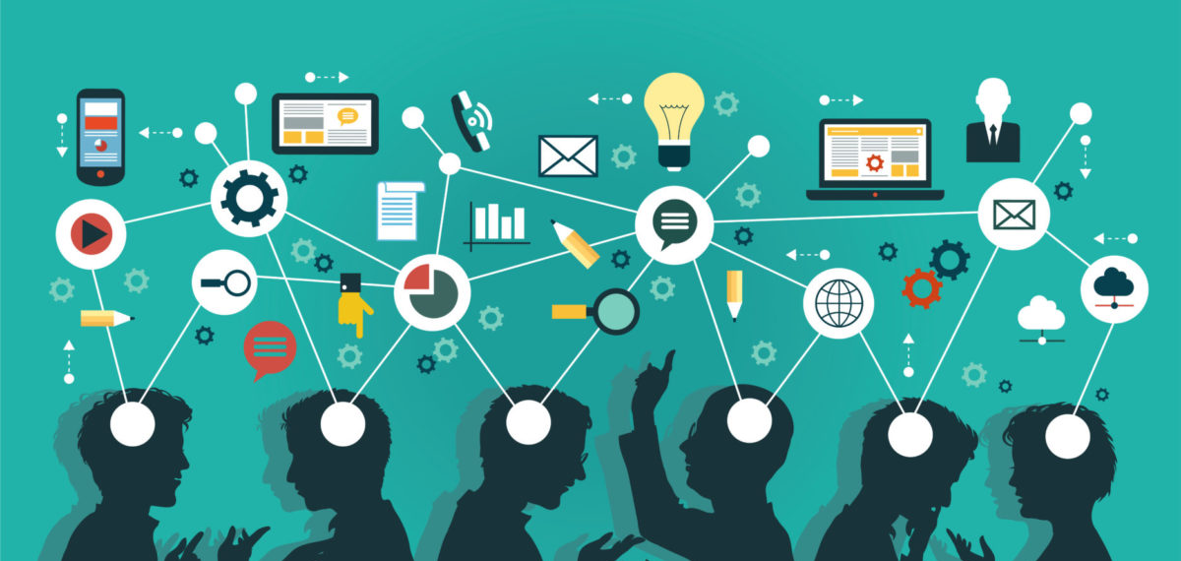
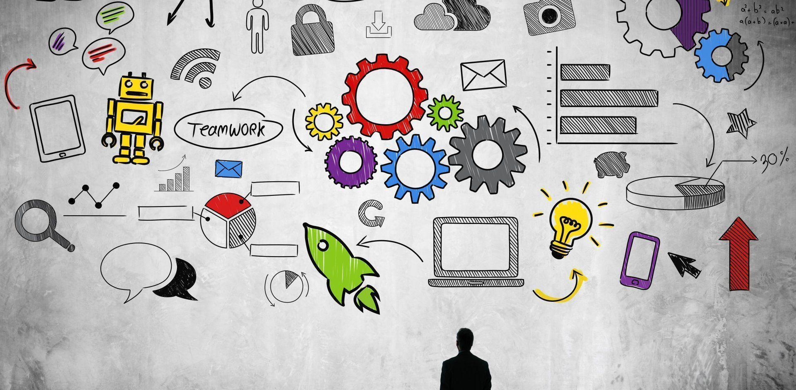
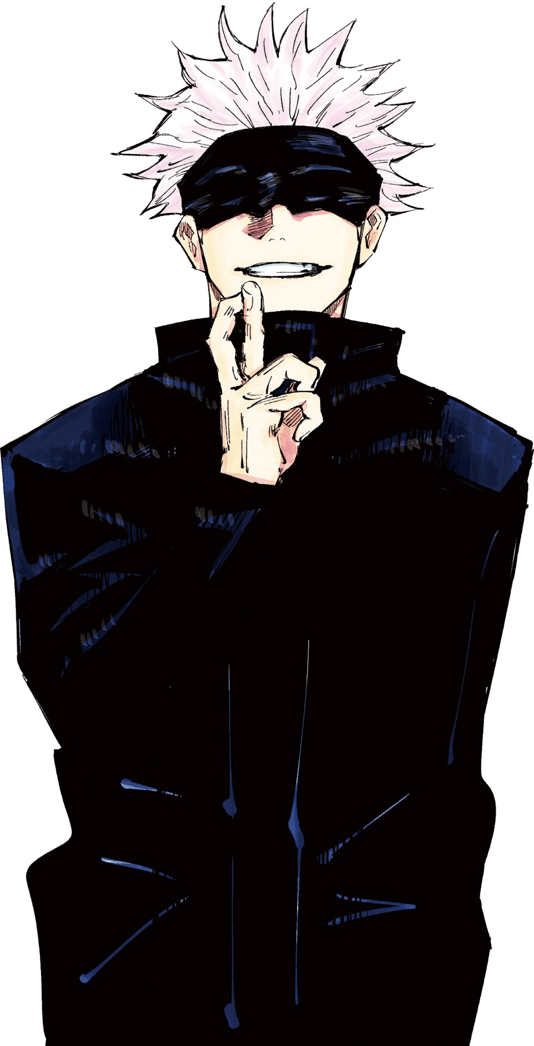
Done Until Now
Bitbucket Repository Management;
SourceTree Cloning;
Trello Team Board Management;
Team List of Values;
Team List of Strengths;
Team List of Weaknesses;
Survival Rules;
We did Team Rules for Maximum Success.

Slide 3
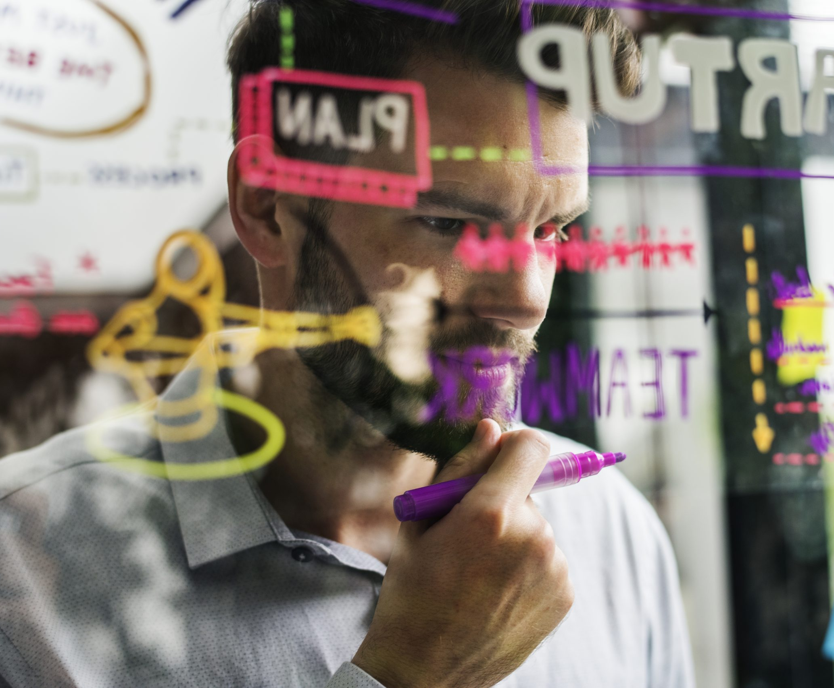
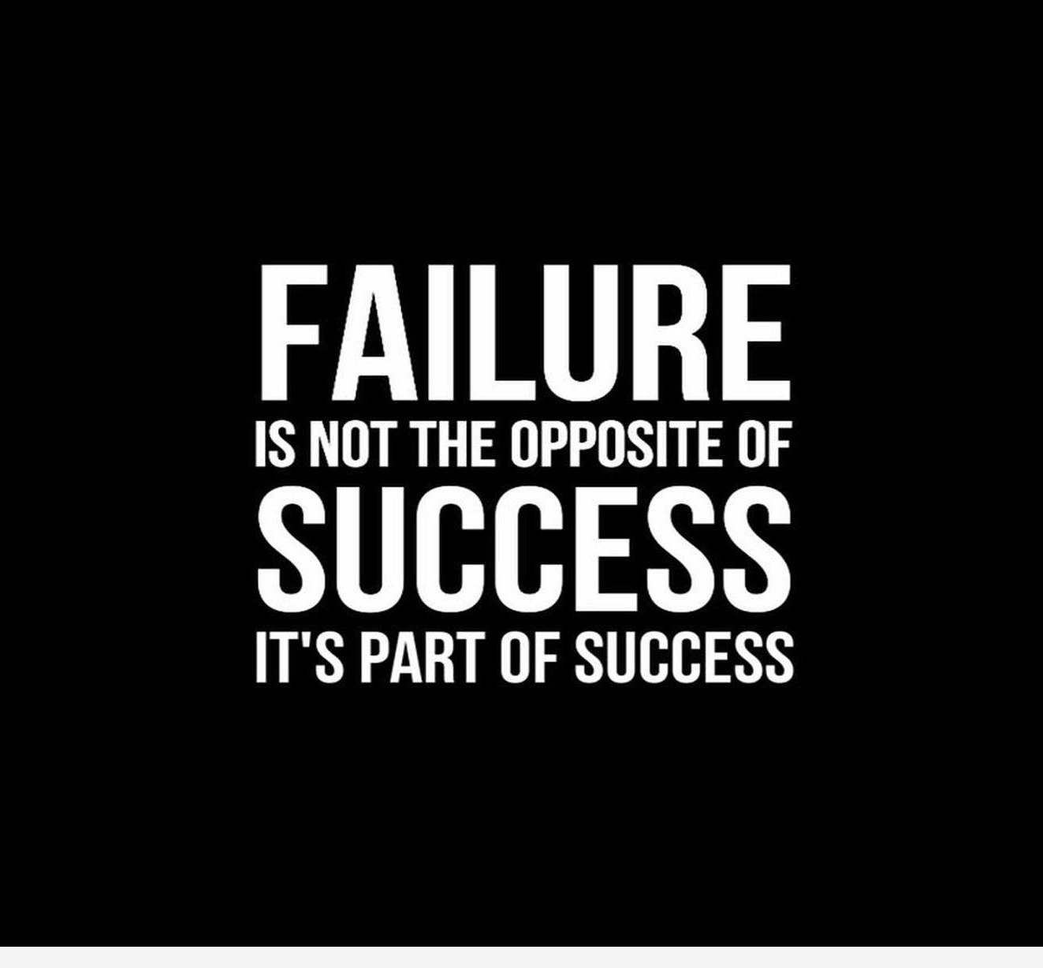
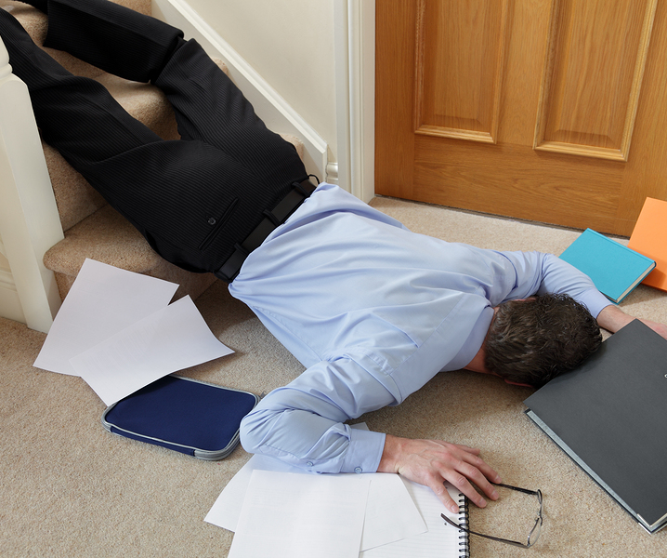
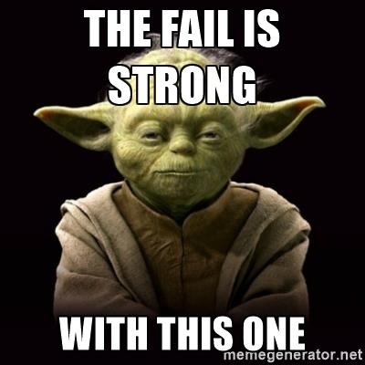
Fail Of The Week
On this last week we started to work on the project a bit late and that is a very irresponsible thing to do.
Be aware of the orthographic errors on our project, create more bond between our mates.
Things To do Better next week:
Learning more about the project itself.
Start doing the group project earlier, work more like a team and not like individuals. .

Slide 4
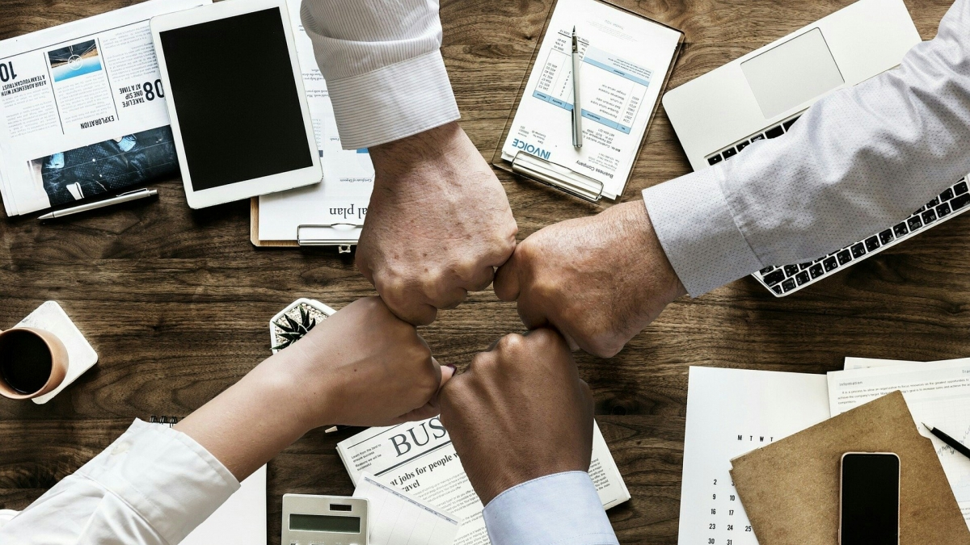
Next Steps

Slide 5

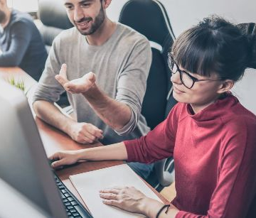
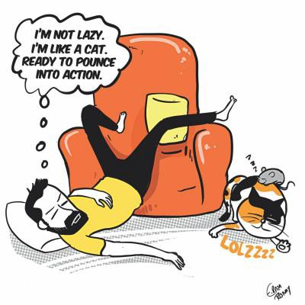
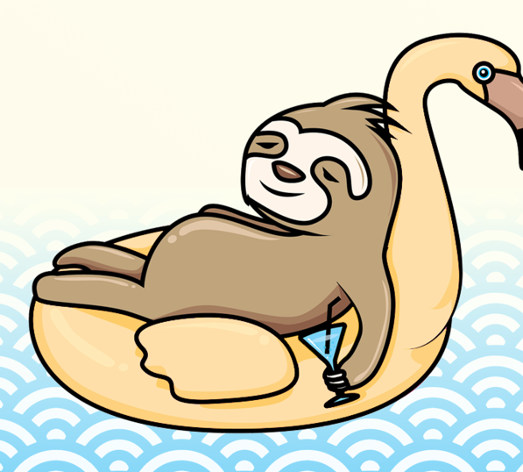
Blocking Issues:
Having all the group persons at the same time;

